Slide 2

Swaminathan Vetri
Architect @ Maersk | Microsoft MVP

Slide 3
DevOps Practices for large distributed teams
Swaminathan Vetri
October 21, 2022

Slide 4
About Me
Dad of 2 little princess ☺
Cloud Solution Architect at Maersk Technology Centre, Bengaluru
Microsoft MVP – Developer Technologies since 2016
Member of .NET Foundation
Twitter/GitHub - @svswaminathan
LinkedIn/YouTube – SwaminathanVetri
Blog – https://swaminathanvetri.in
Photography, Travelling, Blogging, Home automation

Slide 5
Agenda
What is DevOps?
Accelerating Plan -> Code
Accelerating Deployment -> Release
Continuous Monitoring & Feedback
What didn't work ?
Way forward

Slide 6
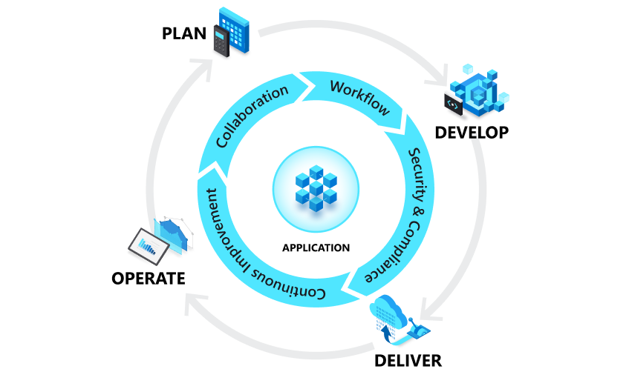
What is DevOps
A compound of development (Dev) and operations (Ops), DevOps is the union of people, process and technology to continually provide value to customers.
What is DevOps? DevOps Explained | Microsoft Azure

Slide 7
DevOps Explained
Develop
Deliver
Ideation
Product definition
Backlog creation
Plan
Coding
Reviews
Automated Testing
Continuous delivery/deployment
Consistent & reliable deployments
Automated Infrastructure provisioning
Operate
Scrum/Kanban
Continuous integration
Continuous monitoring
Telemetry & Alerts
System Availability
Reliability
What is DevOps? DevOps Explained | Microsoft Azure

Slide 8
DevOps culture
Collaboration, Visibility & Alignment
Shift in scope and accountability
Shorter release cycle
Continuous learning
DevOps Culture
What is DevOps? DevOps Explained | Microsoft Azure
Notes:
Collaboration, visibility and alignment
One hallmark of a healthy DevOps culture is collaboration between teams, which starts with visibility. Different teams such as development and IT operations must share their DevOps processes, priorities and concerns with each other. These teams must also plan work together as well as align on goals and measures of success as they relate to the business.
Shifts in scope and accountability
As teams align, they take ownership and become involved in additional lifecycle phases—not just the ones central to their roles. For example, developers become accountable not only to the innovation and quality established in the develop phase, but also to the performance and stability their changes bring in the operate phase. At the same time, IT operators are sure to include governance, security and compliance in the plan and develop phase.
Shorter release cycles
DevOps teams remain agile by releasing software in short cycles. Shorter release cycles make planning and risk management easier since progress is incremental, which also reduces the impact on system stability. Shortening the release cycle also allows organisations to adapt and react to evolving customer needs and competitive pressure.
Continuous learning
High-performing DevOps teams establish a growth mindset. They fail fast and incorporate learnings into their processes, continually improving, increasing customer satisfaction and accelerating innovation and market adaptability. DevOps is a journey, so there is always room to grow.

Slide 9
DevOps practices
Agile Software Development
Version control
Continuous Integration
Continuous Delivery/Deployment
Infrastructure as Code
Configuration Management
Continuous Monitoring
What is DevOps? DevOps Explained | Microsoft Azure

Slide 10
Version Control
Repository management
Consistent repo policies
Branching Strategy
Gitflow based branching strategy
Branch protection/deployment rules
Code Reviews
Automated PR for down merges
Consistent repo creation
Codeowners for mandatory reviews

Slide 11
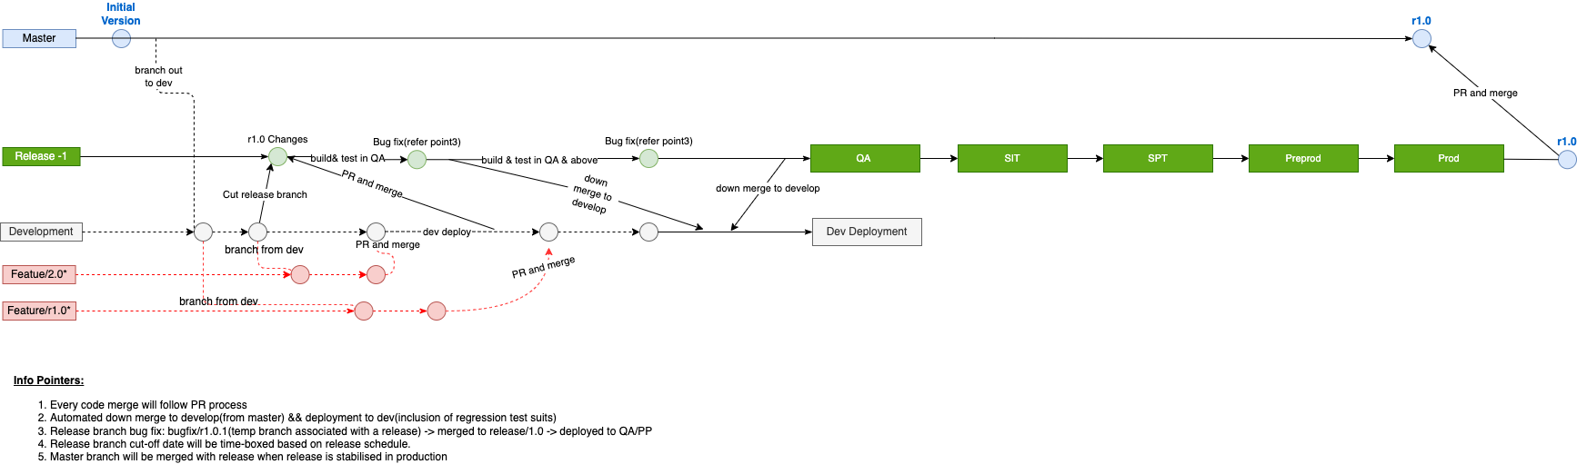
Branching strategy

Slide 12
Demo
Version Control

Slide 13
Continuous Integration
Compile
Unit tests
Sonarqube
Polaris
BlackDuck
Docker Build
Trivy Scans
Docker push
Component Tests
Static Code Scans
Security Scans
Container image Scan
Azure DevOps pipeline as code

Slide 14
Continuous Delivery
Dev
QA
UAT
SPT
Preprod
Prod
QA Integration
Preprod Integration
Prod Sanity
Perf tests
Azure DevOps Release pipelines

Slide 15
Demo
Azure DevOps templates

Slide 16
Kubernetes Deployments
Centralized Helm chart-based deployments
Secrets injected via Hashicorp vault
HPA for auto scaling up/down
On demand configuration deployments
Blue/Green strategy
DR with active/passive setup

Slide 17
Demo
Helm charts

Slide 18
Infrastructure as Code
Stacks and Modules - reusable terraform components
Azure DevOps pipelines
Isolation for Lower and Higher environments
Environment specific Access control
Break glass setup
Infra stack/pipeline per microservice

Slide 19
Demo
Terraform IaC

Slide 20
Continuous Monitoring
Datadog Monitoring
Azure IaaS/PaaS Monitoring
Application Performance and Monitoring
Logs, Metrices and Traces
Alerts with Teams/ServiceNow Integration
SLI/SLOs

Slide 21
Demo
Monitoring

Slide 22
Our learnings/challenges
Adoption of Branching strategy
Addressing security vulnerabilities
Manual Approvals slowing down the release
New Environment provisioning
Monitoring & troubleshooting incidents

Slide 23
DevOps metrics
Deployment
frequency
Lead time to change
Change failure rate
Time to restore service

Slide 24



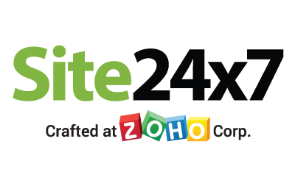


Platinum Partner
Gold Partner
Silver Partner

Slide 25
Q & A

Slide 26
THANK YOU!!!
DevOps practices for large distributed teams
Swaminathan Vetri
Architect, Maersk | Microsoft MVP

